Slide 1

Implementation and Deployment Project of Intelligent System for Enhancing Artistic Expression

Slide 2
Group members | ID
Md. Habibuzzaman [Leader] | 2020-1-60-212
Israfil Arman | 2020-1-60-086
Shafia Hasnin | 2020-1-60-209
Samiu Esika Upoma | 2020-1-60-082
Zarin Tasnim Nuzhat | 2020-1-60-211
Dipayan Bhadra
Adjunct Faculty,
CSE East West University

Slide 3

Project Description
Users engage in artistic expression on a digital canvas, sketching various objects that our intelligent system, powered by a machine learning model, accurately recognizes and assesses for accuracy.
The system then provides constructive feedback based on predefined criteria, guiding users to enhance their drawing skills and fostering a creative and interactive learning experience.

Slide 4

Project Objectives
Implement a user-friendly app for sketching objects.
Identify/detect the object drawn.
Measure the accuracy or correctness of the object drawn.

Slide 5
Project Benefits
Income from AppStore, Play Store and AdSense
Enhanced Drawing Accuracy
Cognitive and Artistic
Development Educational
Tool Positive Learning
Environment Efficient
Resource Utilization
Adaptable Learning Experience

Slide 6
Project Overview
Project Charter
Stakeholder Analysis
Risk Analysis
WBS
Scheduling
Resource Allocation
Developing Gantt Chart
Cost Benefit Analysis

Slide 7
Project Stakeholders
Privacy and Legal Experts
Machine Learning Developers
Educational Institutions
Educational Researchers
Community Representatives
User Interface Designers
Stakeholders
Project Sponsor
Project Owner
Environmental Experts
End Users (Kids and Children, Parents/Guardians)
Project Managers

Slide 8
Project Risks
Machine Learning Model Accuracy
Bias in Machine Learning
Dataset Collection
Computational Resource Constraints
User Engagement
Privacy Concerns
Educational Effectiveness

Slide 9
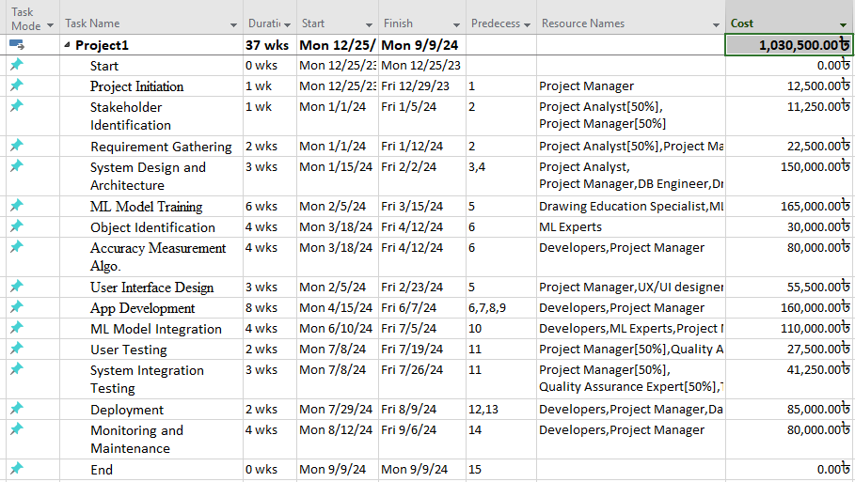
WBS, Scheduling & Resource Allocation

Slide 10
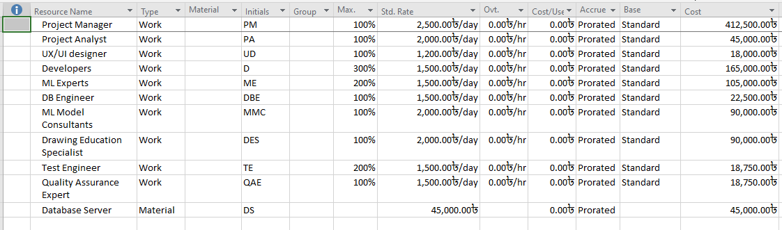
Resource Sheet

Slide 11
Resource Overallocation Handling
We handled Over Allocation manually :
Project Manager[50%]
Project Analyst[50%]
Quality Assurance Expert[50%]
Test Engineer[50%]

Slide 12
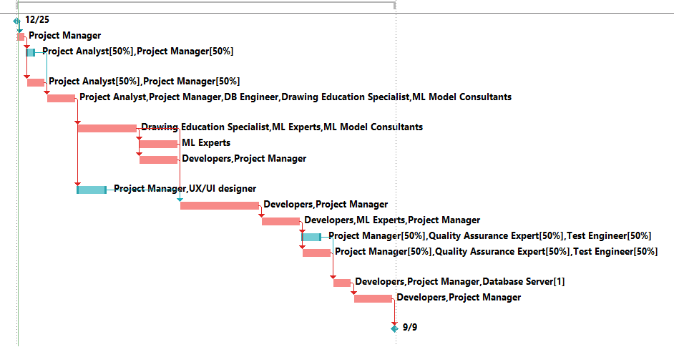
Gantt Chart

Slide 13
Resource Cost Overview

Slide 14
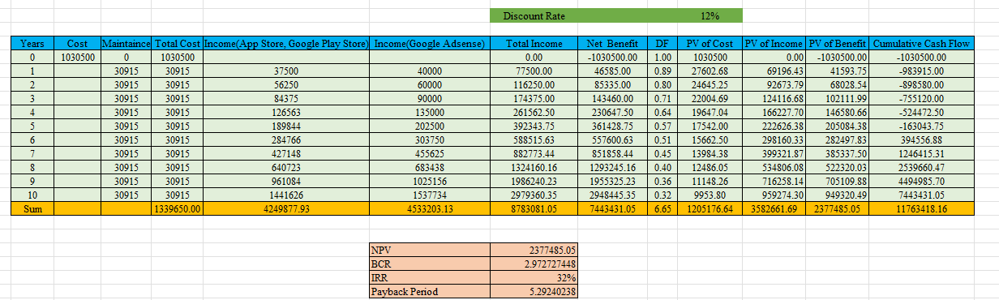
Cost-Benefit Analysis

Slide 15
Cost-Benefit Analysis
NPV (Net Present Value): The project has a positive NPV of $2,377,485.05, indicating that the present value of expected cash flows exceeds the initial investment.
BCR (Benefit-to-Cost Ratio): The Benefit-to-Cost Ratio is 2.97, signifying that for every dollar invested, there are approximately $2.97 in benefits.

Slide 16
Cost-Benefit Analysis
Payback Period 5.29 years

Slide 17
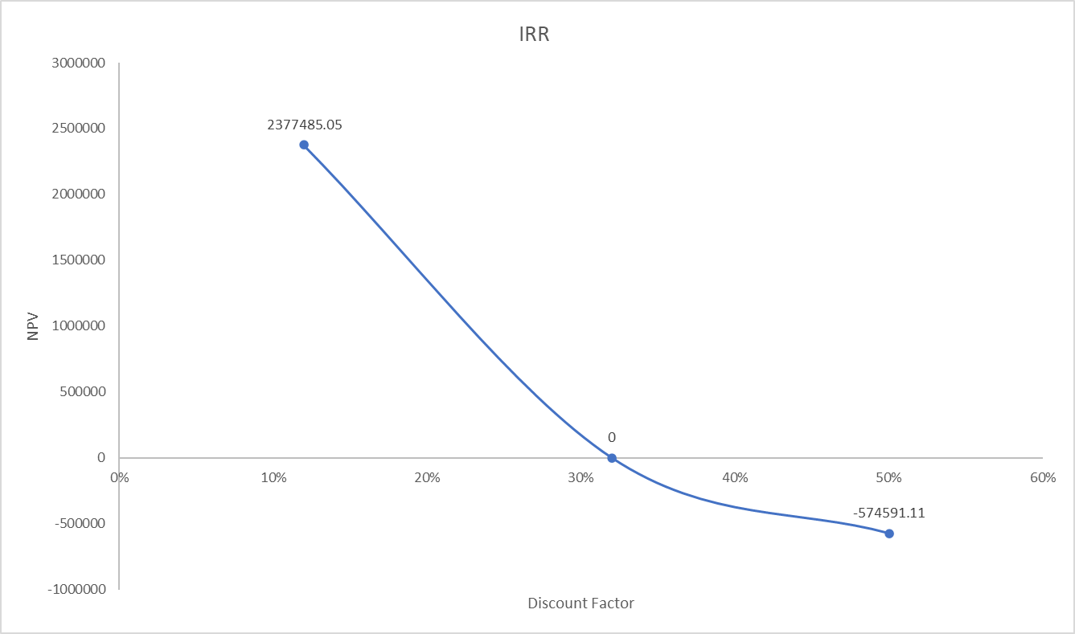
Cost-Benefit Analysis
Internal Rate of Return 32%

Slide 18


